Slide 1
Backend Methods for Visual SLAM
Zhang Handuo
ST Engineering-NTU Corporate Laboratory
School of Electrical and Electronic Engineering Nanyang Technological University
3 August 2018

Slide 2
Outline
Introduction
Preliminaries
Camera Model
Visual Odometry
Backend Methods
EKF
Bundle Adjustment
Sparsity
Marginalization
QA

Slide 3
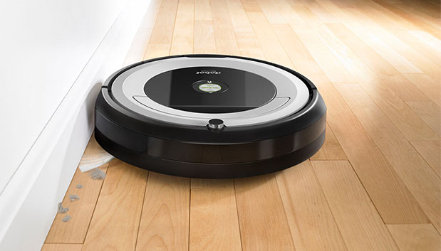
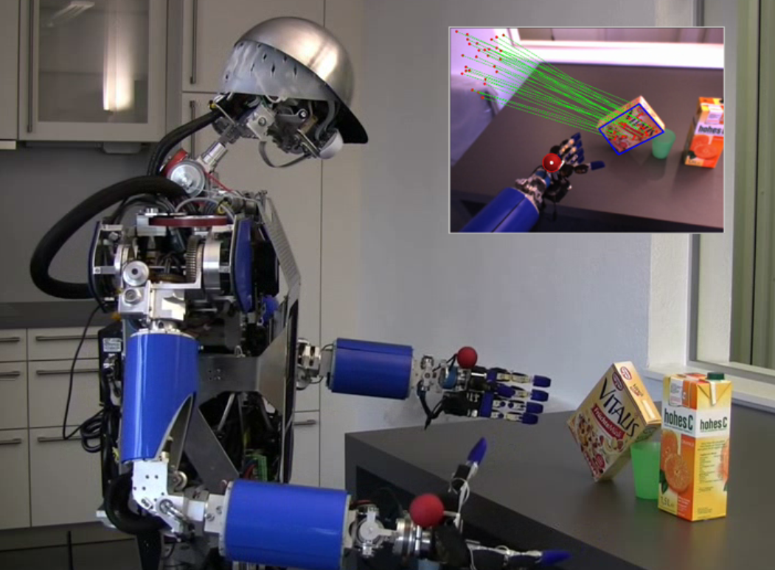
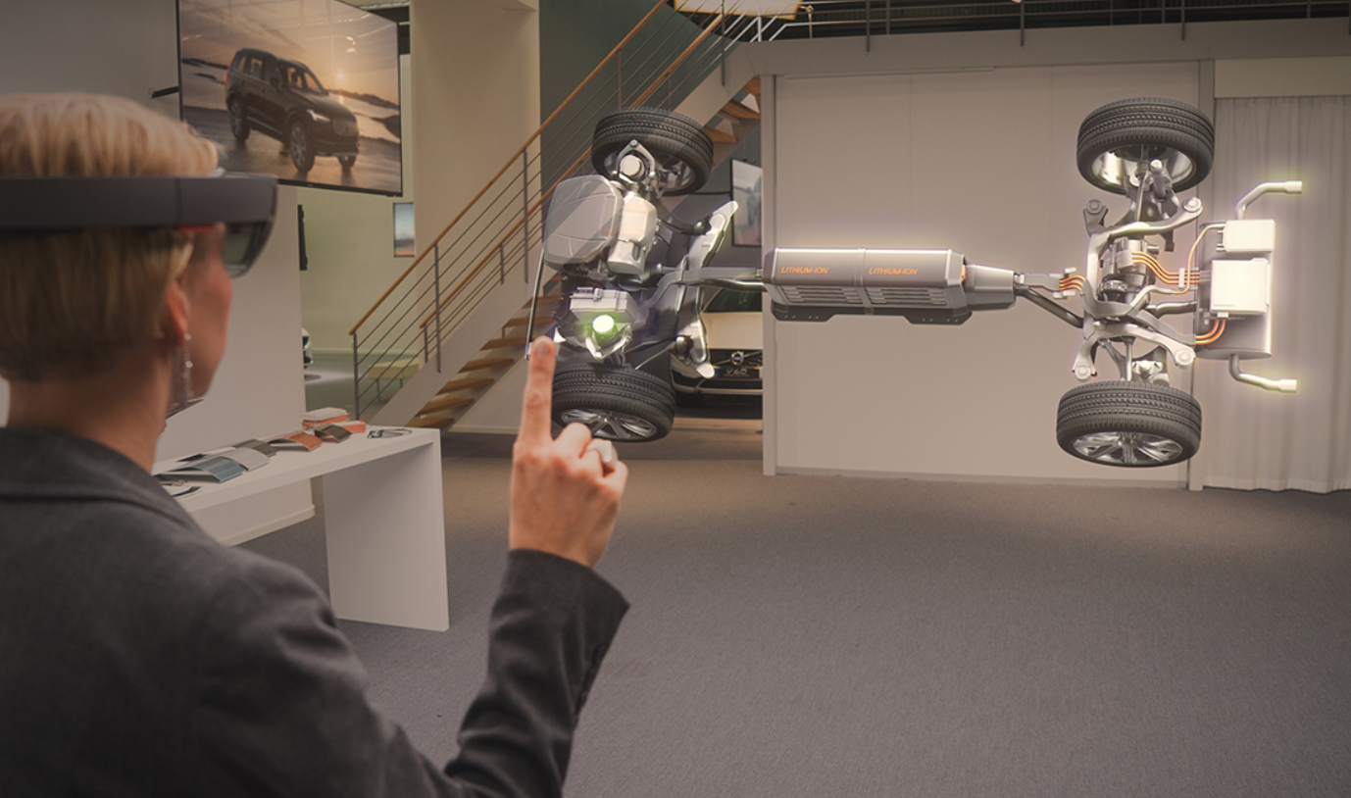
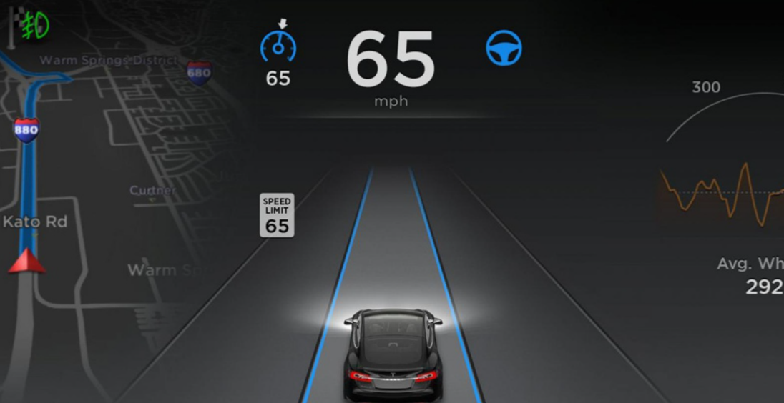
Application
1. Introduction
SLAM: Simultaneous Localization and Mapping
Visual Servo
Intelligent Hardware
Autonomous Driving
Augmented Reality (AR)

Slide 4
Sensor
1. Introduction
Interoceptive sensors: IMU, wheel encoder, cameras, etc.
Laser Sensor Active sensor
Pros :
Accurate
Fast
Calculation amount smaller
Cons :
Large in size
High power consumption
High price
Camera Sensor (visible spectrum) Passive sensor
Pros :
Provide abundant meaningful information (color, texture, shape…)
Low price
Light weight
Cons :
Strong environment assumptions
Large amount of calculation
Numerical instabilities, ill-conditioned problems, image noise
Exteroceptive sensors: GPS, artificial markers, etc.
Notes:
Assumptions: sufficient illumination, dominance of static scene over moving objects, enough texture to allow apparent motion to be extracted, sufficient scene overlap between consecutive frames

Slide 5
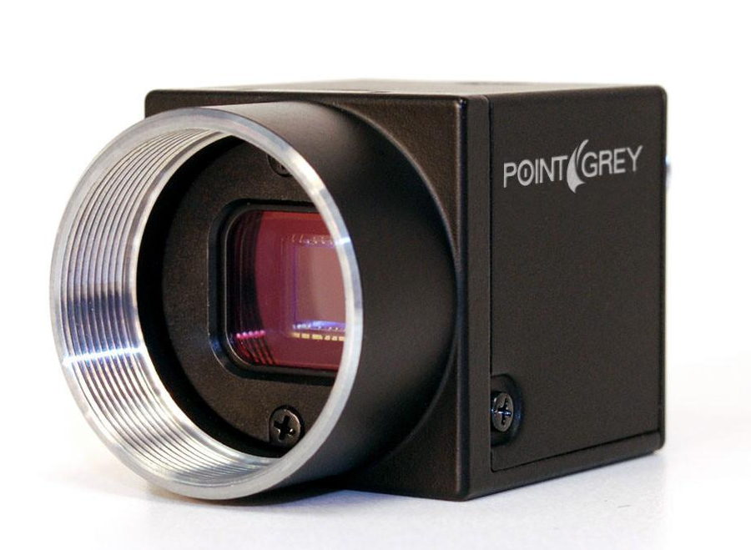
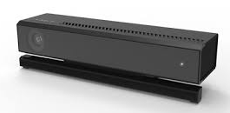
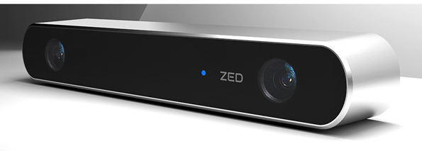
Sensor
1. Introduction
Monocular
Stereo
RGB-D
Low cost
Acquire depth
Active acquire depth
No range limitation
No range limitation
Better reconstruction
Scale uncertainty
Complex configuration
Small detection range
Initialization issue
Complex calculation
Small detection range
Sensitive to material textures
Notes:
Assumptions: sufficient illumination, dominance of static scene over moving objects, enough texture to allow apparent motion to be extracted, sufficient scene overlap between consecutive frames

Slide 6
Definition
1. Introduction
1. Introduction
SFM
VSLAM
VO
Local consistency
Input: unordered image sets
Global consistency
Output: 6DOF pose and 3D reconstruction
Input: sequential camera frames
Output: 6DOF pose estimation of camera

Slide 7
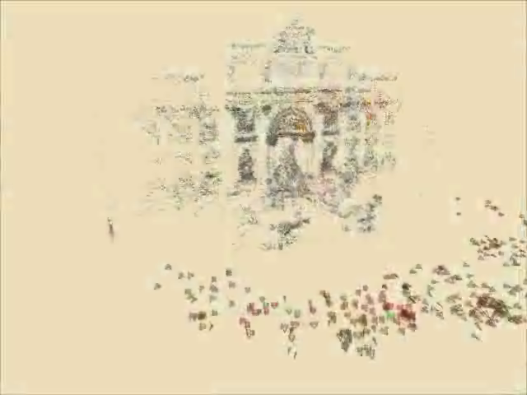
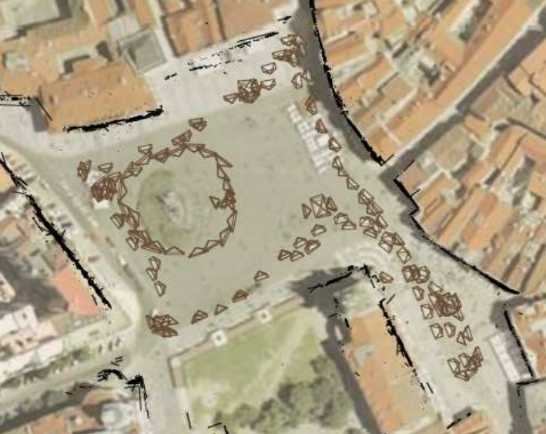
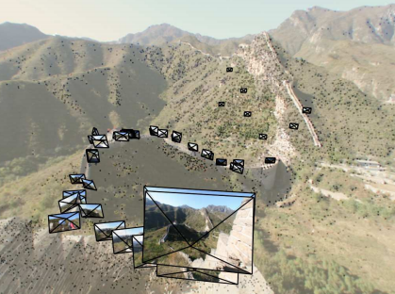
SFM
1. Introduction
1. Introduction
SFM: Structure from Motion
Snavely, N., Seitz, S. M., & Szeliski, R. (2006, July). Photo tourism: exploring photo collections in 3D. In ACM transactions on graphics (TOG) (Vol. 25, No. 3, pp. 835-846). ACM.

Slide 8
VSLAM
1. Introduction
1. Introduction
Internal State Estimation
Surrounding Perception
Unknown initial location
Unknown Environment
Know where I am w.r.t. initial place
Sense the environment
Mapping
Calculate 6D pose
Construct model and optimize to eliminate noises

Slide 9
VSLAM
1. Introduction
1. Introduction
Challenges
No prior knowledge
Real-time
Long-term travelling (Drift, memory usage)
Robustness to sudden environment change (illumination, scale, motion)
Dynamic environment
Sensor fusion
Mapping (integrates with navigation and reconstruction)

Slide 10
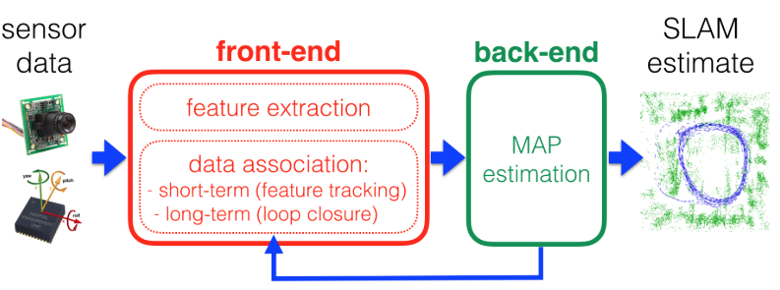
VSLAM
1. Introduction
Front-end is responsible for:
Feature extraction, matching, outlier removal
Loop closure detection
Back-end is responsible for:
Pose and structure optimization (g2o, Ceres, GTSAM)

Slide 11
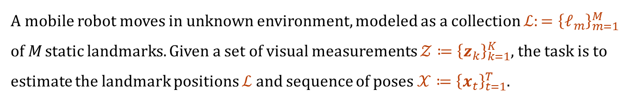
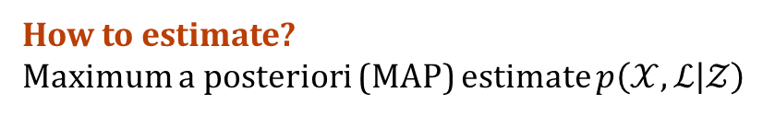
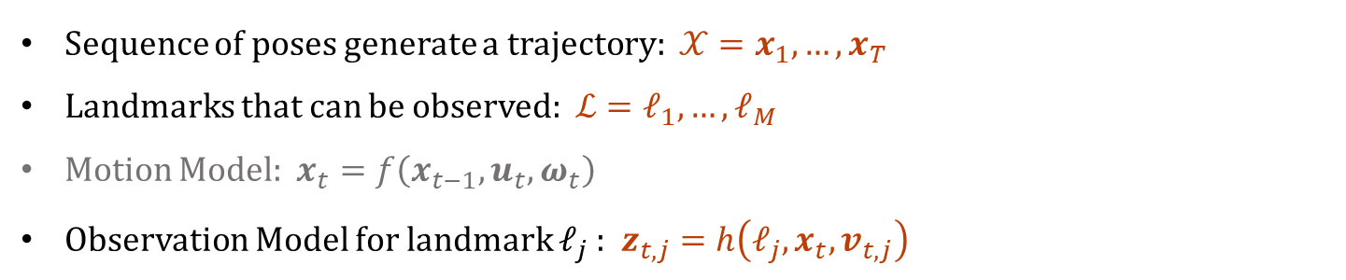
2. Preliminaries
1. Mathematical Formulation of Visual SLAM
A mobile robot moves in unknown environment, modeled as a collection $ℒ:={\left\{ℓ_{m}\right\}}_{m=1}^{M}$ of M static landmarks. Given a set of visual measurements $𝒵≔{\left\{z_{k}\right\}}_{k=1}^{K}$, the task is to estimate the landmark positions $ℒ$ and sequence of poses $𝒳≔{\left\{x_{t}\right\}}_{t=1}^{T}$.
2. Classic SLAM Solution: Probabilistic Modeling
Sequence of poses generate a trajectory: $𝒳=x_{1}, …, x_{T}$
Landmarks that can be observed: $ℒ=ℓ_{1}, …, ℓ_{M}$
Motion Model: $x_{t}=f\left(x_{t−1}, u_{t},ω_{t}\right)$
Observation Model for landmark $ℓ_{j}$: $z_{t,j}=h\left({ℓ_{j},x}_{t}, v_{t,j}\right)$
How to estimate?
Maximum a posteriori (MAP) estimate $p\left(𝒳,ℒ | 𝒵\right)$

Slide 12
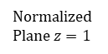

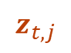
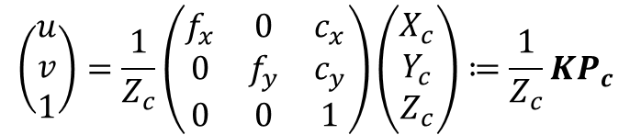
2.1 Camera Model
2. Preliminaries
Normalized Plane $z=1$
P
Image Coordinate
Camera Coordinate
p
O_{c}
z
x_{c}
Image Coordinate
y_{c}
Normalized Coordinate
$$\left(\begin{matrix}u \\ v \\ 1\end{matrix}\right)=\frac{1}{Z_{c}}\left(\begin{matrix}f_{x} & 0 & c_{x} \\ 0 & f_{y} & c_{y} \\ 0 & 0 & 1\end{matrix}\right)\left(\begin{matrix}X_{c} \\ Y_{c} \\ Z_{c}\end{matrix}\right)≔\frac{1}{Z_{c}}KP_{c}$$
$$z_{t,j}$$
$$\breve{ℓ_{j}}$$

Slide 13

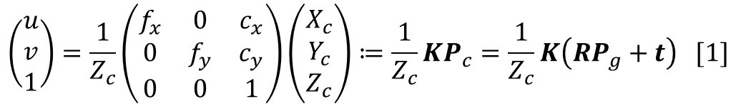
2.1 Camera Model
2. Preliminaries
Normalized Plane $z=1$
P
Image Coordinate
Camera Coordinate
p
O_{c}
z_{c}
x_{c}
Image Coordinate
z_{g}
y_{c}
Global Coordinate
Normalized Coordinate
y_{g}
x_{g}
$$\left(\begin{matrix}u \\ v \\ 1\end{matrix}\right)=\frac{1}{Z_{c}}\left(\begin{matrix}f_{x} & 0 & c_{x} \\ 0 & f_{y} & c_{y} \\ 0 & 0 & 1\end{matrix}\right)\left(\begin{matrix}X_{c} \\ Y_{c} \\ Z_{c}\end{matrix}\right)≔\frac{1}{Z_{c}}KP_{c}=\frac{1}{Z_{c}}K\left(RP_{g}+t\right) [1]$$
$$z_{t,j}$$
$$\breve{ℓ_{j}}$$
$$ℓ_{j}$$

Slide 14
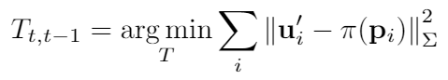
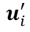
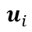
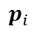

2.2 Visual Odometry
2. Preliminaries
Feature based Visual Odometry
1. Extract & match features (+RANSAC)
$$T_{t,t−1}$$
$$u_{i}$$
$$u_{i}^{′}$$
2. Minimize the Reprojection error
$$p_{i}$$

Slide 15
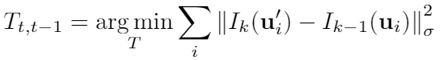
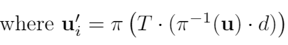
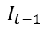
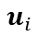
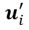

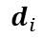
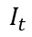
2.2 Visual Odometry
2. Preliminaries
Direct Image Alignment
$$T_{t,t−1}$$
Minimize the per-pixel intensity difference — photometric error
$$I_{t−1}$$
$$I_{t}$$
$$u_{i}$$
$$u_{i}^{′}$$
$$d_{i}$$
$$p_{i}$$
Dense: DTAM [Newcombe et al. `11] 300,000+ pixels
Semi-Dense: LSD-SLAM [Engel et al. `14] 10,000 pixels
Sparse: SVO [Forster et al. `14] 2,000 pixels

Slide 16
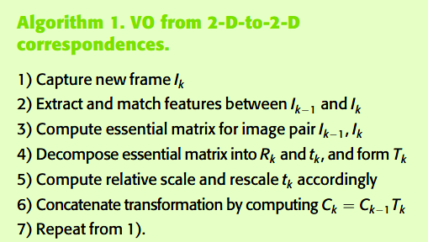
2.2 Visual Odometry
2. Preliminaries
Monocular SLAM Initialization — 2D-to-2D correspondences [1]
Epipolar constraint
Eight-point algorithm
Five-point algorithm
DLT method
SVD
Limitation
Scale ambiguity
Pure rotation issue
[1] Scaramuzza, D., & Fraundorfer, F. (2011). Visual odometry [tutorial]. IEEE robotics & automation magazine, 18(4), 80-92.

Slide 17
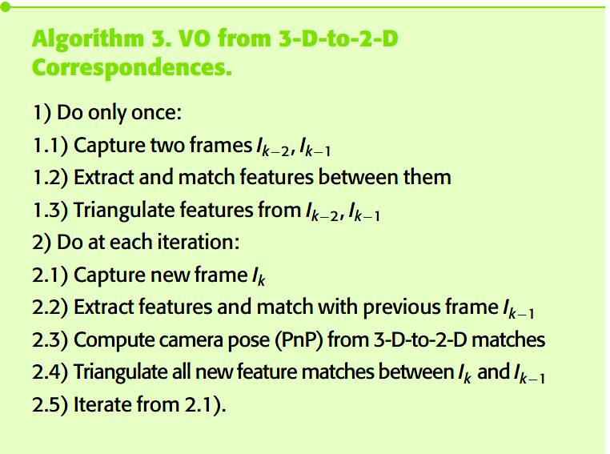
2.2 Visual Odometry
2. Preliminaries
3D-to-2D correspondences
Perspective-n-Point (PnP):
DLT
P3P
Efficient PnP
UPnP

Slide 18
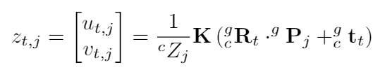
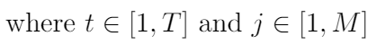
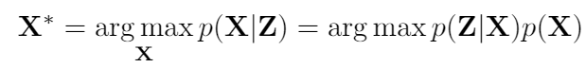
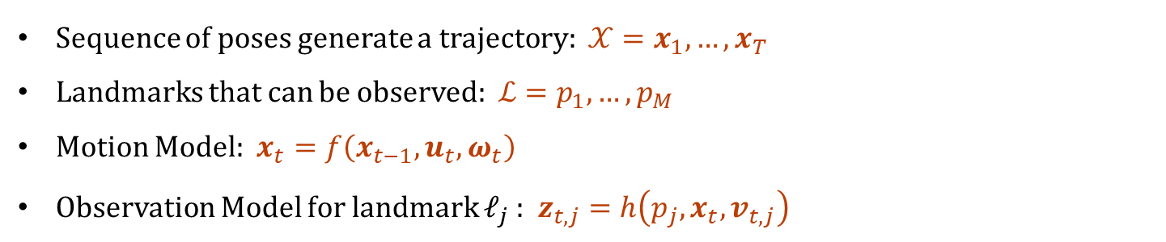
3. Backend
Recall
Probabilistic Modeling
Sequence of poses generate a trajectory: $𝒳=x_{1}, …, x_{T}$
Landmarks that can be observed: $ℒ=p_{1}, …, p_{M}$
Motion Model: $x_{t}=f\left(x_{t−1}, u_{t},ω_{t}\right)$
Observation Model for landmark $ℓ_{j}$: $z_{t,j}=h\left({p_{j},x}_{t}, v_{t,j}\right)$
Maximum a posteriori (MAP) estimate $p\left(𝒳,ℒ | 𝒵\right)$

Slide 19
3. Backend
3.1 EKF
Main idea
Linearize measurement functions at linearization point and use Gaussian distribution to approximate the nonlinear noises.
Predict - Update Kalman filter processes.
Limitation
Markov property assumption. So if the current frame is related to historical data (loop closure), the filter fails.
EKF is implemented by linearizing the observation model. High-order item was abandoned and the linearization point is only an estimated value, which leads to inconsistency.
Quadratic cost both in storage and update time.

Slide 20
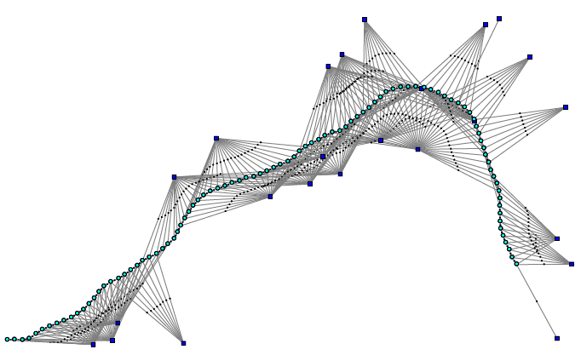
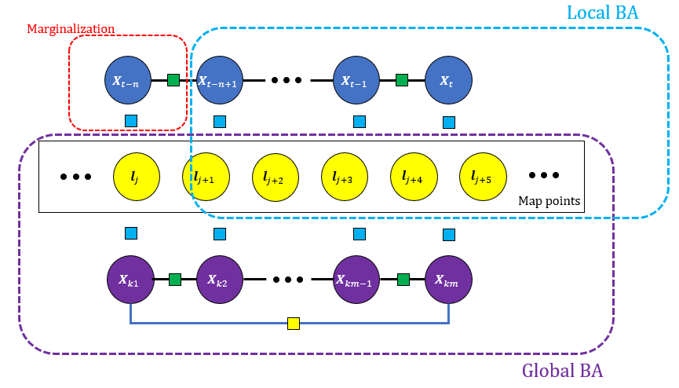
3. Backend
3.2 Bundle Adjustment
MAP Inference for Nonlinear Factor Graphs

Slide 21
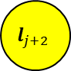
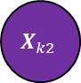
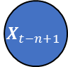
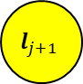

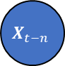
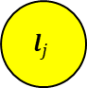
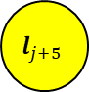
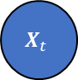
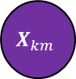
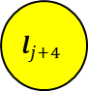
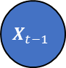
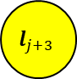
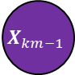
3. Backend
3.2 Bundle Adjustment
MAP Inference for Nonlinear Factor Graphs
Local BA
Marginalization
$$X_{t−n}$$
$$X_{t−n+1}$$
$$X_{t−1}$$
$$X_{t}$$
$$l_{j}$$
$$l_{j+1}$$
$$l_{j+2}$$
$$l_{j+3}$$
$$l_{j+4}$$
$$l_{j+5}$$
Map points
$$X_{k1}$$
$$X_{k2}$$
$$X_{km−1}$$
$$X_{km}$$
Global BA

Slide 22













3. Backend
3.2 Bundle Adjustment
MAP Inference for Nonlinear Factor Graphs
$$X_{1}$$
$$X_{2}$$
$$X_{3}$$
$$X^{MAP}=\begin{matrix}argmax \\ X\end{matrix}φ\left(X\right)$$
$$=\begin{matrix}argmax \\ X\end{matrix}\prod_{i}{φ_{i}}\left(X_{i}\right)$$
Assume measurement follow Gaussian distribution
$$l_{1}$$
$$l_{2}$$
$$φ_{i}\left(X_{i}\right)∝exp\left\{−\frac{1}{2}{\left\|h_{i}\left(X_{i}\right)−z_{i}\right\|}_{Σ_{i}}^{2}\right\}$$
$$e_{ij}$$
Measurement equation：
Error function
Minimizing cost function such that
$$[2]$$
Least Squares Optimization Problem [2]
[2] Grisetti, G., Kummerle, R., Stachniss, C., & Burgard, W. (2010). A tutorial on graph-based SLAM. IEEE Intelligent Transportation Systems Magazine, 2(4), 31-43.

Slide 23









3. Backend
3.2 Bundle Adjustment
Linearization
$$X_{1}$$
$$X_{2}$$
$$X_{3}$$
state update vector
$$[3]$$
Initial guess
measurement Jacobian of $e_{ij}$
$$J_{ij}≔\frac{∂{e_{ij}(x}_{ij})}{∂x_{ij}}|_{{\overline{x}}_{ij}}$$
$$l_{1}$$
$$l_{2}$$
whitened Jacobian matrices $Ω_{ij}^{−\frac{1}{2}}J_{ij}$
Information matrix $H_{ij}$
$$H∆x^{∗}=−b$$
$$[4]$$
[3] Kümmerle, R., Grisetti, G., Strasdat, H., Konolige, K., & Burgard, W. (2011, May). g 2 o: A general framework for graph optimization. In Robotics and Automation (ICRA), 2011 IEEE International Conference on (pp. 3607-3613). IEEE.

Slide 24



Parametrization
3. Backend
Camera Poses
$$X_{t}=\left[\begin{matrix}R_{t} & t_{k} \\ 0 & 1\end{matrix}\right]$$
Euclidean Space: $X_{t}∈ℝ^{4×4}$ | $R_{t}∈$ $ℝ^{3×3}$, $t_{k}$ $∈ℝ^{3}$
Special Euclidean Space: $X_{t}∈SE\left(3\right)$ | $R_{t}∈$SO(3), $t_{k}$ $∈ℝ^{3}$
Rigid body rotation constraints
To cope with easier optimization
Lie Group
SO(3)
Lie Algebra
$𝔰𝔬(3)$
3D Landmarks
Euclidean XYZ Param:
$l_{j}∈ℝ^{3}$: 3D position
Inverse Depth Param [4]:
$l_{j}∈ℝ^{6}$: ${\left(x_{j},y_{j}\text{,} z_{j}\text{ , }θ_{j}\text{ , }φ_{j}\text{ , }ρ_{j}\right)}^{Τ}$6D state vector
[4] Civera, J., Davison, A. J., & Montiel, J. M. (2008). Inverse depth parametrization for monocular SLAM. IEEE transactions on robotics, 24(5), 932-945.

Slide 25







Parametrization
3. Backend
Camera Poses
Special Euclidean Space: $X_{t}∈SE\left(3\right)$ | $R_{t}∈$SO(3), $t_{k}$ $∈ℝ^{3}$
$T\left(t\right)=exp(ξ^{∧}\left(t\right)$)
Lie Group
SE(3): $T$
Lie Algebra
$𝔰𝔢(3)$:$ξ^{∧}∈ℝ^{4×4}$
$\dot{T\left(t\right)}$=$ξ^{∧}\left(t\right)T\left(t\right)$
$$T\left(t+δt\right)≈T\left(t\right)+\dot{T\left(t\right)}δt=T\left(t\right)+ξ^{∧}\left(t\right)T\left(t\right)δt=\left(I+ξ^{∧}\left(t\right)δt\right)T(t)$$
$$[5]$$
Linearization --- Perturbation model [5]
$δξ$ is the corresponding lie algebra of perturbation $ΔT=exp⁡(δξ^{∧})$
$$\frac{∂(Tp)}{∂δξ}=\left[\begin{matrix}I & −{(Rp+t)}^{∧} \\ 0^{T} & 0^{T}\end{matrix}\right]$$
$$[6]$$
[5] Barfoot, T. D. (2017). State Estimation for Robotics. Cambridge University Press.

Slide 26

Parametrization
3. Backend
3D Landmarks
Inverse Depth Param [4]:
$l_{j}∈ℝ^{6}$: ${\left(x_{j},y_{j}\text{,} z_{j}\text{ , }θ_{j}\text{ , }φ_{j}\text{ , }ρ_{j}\right)}^{Τ}$6D state vector
[4] Civera, J., Davison, A. J., & Montiel, J. M. (2008). Inverse depth parametrization for monocular SLAM. IEEE transactions on robotics, 24(5), 932-945.

Slide 27






3. Backend
3.2 Bundle Adjustment
State update
$$X_{1}$$
$$X_{2}$$
$$X_{3}$$
state update vector
$$H∆x^{∗}=−b$$
$$[4]$$
Initial guess
measurement Jacobian of $e_{ij}$
$$x^{∗}=\check{x}+∆x^{∗}$$
$$l_{1}$$
$$l_{2}$$
$$x^{∗}=∆x^{∗}⨁\check{x}$$
$$[7]$$
$⊕$ composition on manifold
Represents perturbation
Iterative Optimization methods
Gauss-Newton method
Levenberg-Marquardt method (Trust region method)
Powell’s dogleg algorithm
Off the shelf package: g2o, gtsam, ceres

Slide 28

3. Backend
3.2 Bundle Adjustment
Inside each iteration
Cholesky Factorization --- CHOLMOD, CXSParse
QR Factorization --- SPQR, Eigen QR module

Slide 29

















3. Backend
3.2 Visual SLAM BA
$$[8]$$
Jacobian matrix - Partial derivative of F w.r.t landmark position $p$
$$e_{ij}∈ℝ^{2}$$
$$∈ℝ^{6m}$$
$$∈ℝ^{3n}$$
$D_{ij}$ $∈ℝ^{2×6}$
$$[9]$$
$E_{ij}$ $∈ℝ^{2×3}$
Jacobian matrix - Partial derivative of F w.r.t camera pose $ξ$
$$s\left[\begin{matrix}u \\ v \\ 1\end{matrix}\right]=K⋅exp⁡(ξ^{∧})\left[\begin{matrix}X \\ Y \\ Z \\ 1\end{matrix}\right]$$
$$D_{ij}=\frac{∂F}{∂δξ}=\lim_{δξ→0}{\frac{e\left(δξ⨁ξ\right)}{δξ}=\frac{∂F}{∂P′}⋅\frac{∂P′}{∂δξ}}$$
$$[10]$$
$$E_{ij}=\frac{∂F}{∂P}=\frac{∂F}{∂P′}⋅\frac{∂P^{′}}{∂P}=\frac{∂F}{∂P′}R$$
$P^{′}:$ 3D point in camera coordinate
$$[11]$$

Slide 30















3.3 Sparsity
3. Backend
$$[9]$$
$$[8]$$
$$[12]$$
$C_{1}$
$C_{2}$
$P_{1}$
$P_{2}$
$P_{3}$
$P_{4}$
$P_{5}$
$P_{6}$
$J_{11}$ =

Slide 31
















3.3 Sparsity
3. Backend
$C_{1}$
$C_{2}$
$P_{1}$
$P_{2}$
$P_{3}$
$P_{4}$
$P_{5}$
$P_{6}$
$J_{11}$
$J_{12}$
$J_{13}$
J =
$J_{14}$
=
$J_{23}$
$J_{24}$
$J_{25}$
$J_{26}$

Slide 32

3.3 Sparsity
3. Backend
$C_{1}$
$C_{2}$
$P_{1}$
$P_{2}$
$P_{3}$
$P_{4}$
$P_{5}$
$P_{6}$
$J_{11}$
$J_{12}$
$J_{13}$
J =
$J_{14}$
=
$J_{23}$
$J_{24}$
$J_{25}$
$J_{26}$
$H=J^{T}J$=

Slide 33

3.3 Sparsity
3. Backend
$C_{1}$
$C_{2}$
$P_{1}$
$P_{2}$
$P_{3}$
$P_{4}$
$P_{5}$
$P_{6}$
$J_{11}$
$J_{12}$
$J_{13}$
J =
$J_{14}$
=
$J_{23}$
$J_{24}$
$J_{25}$
$J_{26}$
$H=J^{T}J$=
$$e_{26}$$

Slide 34
















3.3 Sparsity
3. Backend
Schur Complement [6]
$$H∆x^{∗}=b$$
$$B$$
$$E$$
$$\left[\begin{matrix}B & E \\ E^{T} & C\end{matrix}\right]\left[\begin{matrix}Δx_{c} \\ Δx_{p}\end{matrix}\right]=\left[\begin{matrix}b_{v} \\ b_{w}\end{matrix}\right]$$
$$[13]$$
$$\left[\begin{matrix}I & −EC^{−1} \\ 0 & I\end{matrix}\right]\left[\begin{matrix}B & E \\ E^{T} & C\end{matrix}\right]\left[\begin{matrix}Δx_{c} \\ Δx_{p}\end{matrix}\right]=\left[\begin{matrix}I & −EC^{−1} \\ 0 & I\end{matrix}\right]\left[\begin{matrix}b_{v} \\ b_{w}\end{matrix}\right]$$
$$[14]$$
$$C$$
$$E^{T}$$
$$\left[\begin{matrix}B−EC^{−1}E^{T} & 0 \\ E^{T} & C\end{matrix}\right]\left[\begin{matrix}Δx_{c} \\ Δx_{p}\end{matrix}\right]=\left[\begin{matrix}b_{v}−EC^{−1}b_{w} \\ b_{w}\end{matrix}\right]$$
$$[15]$$
The second row is eliminated to obtain the Schur complement that involves only $Δx_{c}$.
$$(B−EC^{−1}E^{T})Δx_{c}{=b}_{v}−EC^{−1}b_{w}$$
$$[16]$$
$$S$$
$$b_{s}$$
[6] Sibley, G., Matthies, L., & Sukhatme, G. (2010). Sliding window filter with application to planetary landing. Journal of Field Robotics, 27(5), 587-608.

Slide 35







3. Backend
3.4 Marginalization
Sliding Window
$$x={\left[x_{m},x_{b},x_{r}\right]}^{T}$$
$$z={\left[z_{m},z_{b},z_{r}\right]}^{T}$$
separator
Variable to be marginalized
Variable related
Follow equation 16
$$(H_{mm}−H_{bm}H_{bb}^{−1}H_{bm}^{T})Δx_{b}{=b}_{m}−H_{bm}H_{bb}^{−1}b_{b}$$
$$[17]$$

Slide 36




3. Backend
3.4 Marginalization
First Jacobian Estimation [7]:
For $x_{b}$, we fix the linearization point ${\breve{x}}_{b}$and no longer use updated $x_{b}$ to get Jacobian.
Follow equation 17
$$(H_{mm}−H_{bm}H_{bb}^{−1}H_{bm}^{T})Δx_{b}{=b}_{m}−H_{bm}H_{bb}^{−1}b_{b}$$
$$x^{new}←log⁡(δ⨁e^{x})$$
$$ζ_{0}^{new}←x⨁ζ_{0}$$
$$x←0$$
[7] Huang, G. P., Mourikis, A. I., & Roumeliotis, S. I. (2009). A first-estimates Jacobian EKF for improving SLAM consistency. In Experimental Robotics(pp. 373-382). Springer Berlin Heidelberg.

Slide 37


Elimination Order:
[8] Kaess, M., Johannsson, H., Roberts, R., Ila, V., Leonard, J. J., & Dellaert, F. (2012). iSAM2: Incremental smoothing and mapping using the Bayes tree. The International Journal of Robotics Research, 31(2), 216-235.
[9] Frank Dellart, Michael Kaess. (2017). Factor Graph for Robot Perception.

Slide 38
3. Backend
3.5 Pose-only BA

Slide 39
Q&A

